Slide 1

Messaging in .NET via MassTransit
Arturs Karbone
14-March-2019
https://www.linkedin.com/in/arturkarbone/
Training course http://devchampions.com/training/unit_and_integration_testing/
Blog http://craftsmanatwork.guru/

Slide 2
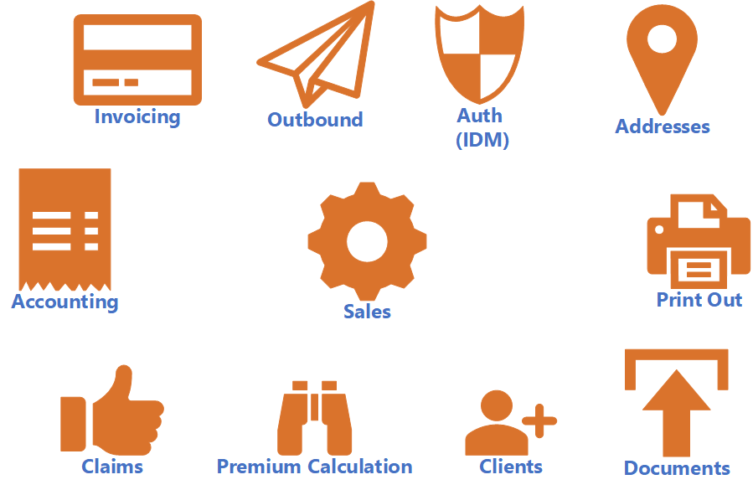
A distributed system. An insurance company

Slide 3
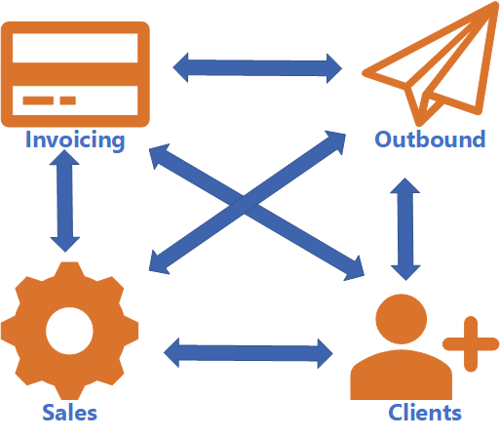
Integration patterns: rpc (soap/rest)
Tightly coupled
Complexity grows
Need to modify existing code, when a new system appears
What if system X is down for maintenance?

Slide 4
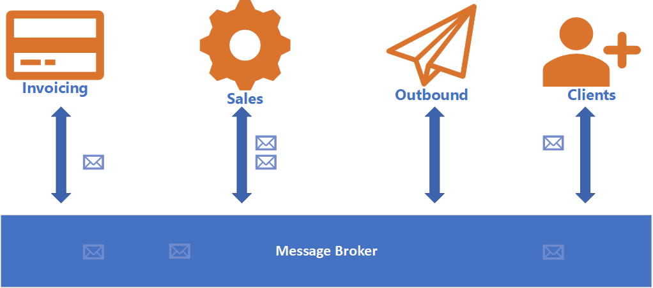
Integration patterns: messaging
Decoupled
Share only messaging contract
Truly async communication: the message will reach the destination

Slide 5

Message queue (first in first out)

Slide 6
Transport theory
A Queue (Friend’s mailbox)
Know your friend’s exact address
Have a ride
Put the letter into his mailbox
An Exchange (a post office)
Know your friend’s exact address
Bring the letter to the post office
They will take care of the routing

Slide 7
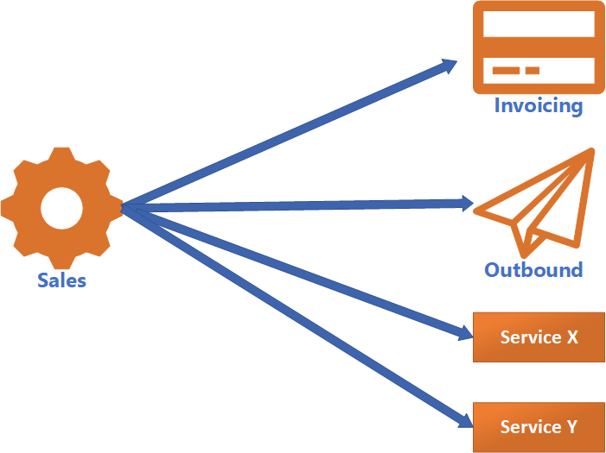
messaging patterns: broadcast/Event

Slide 8
messaging patterns: broadcast/Event
Events should be expressed in a noun-verb (past tense) sequence:
PolicyIssued
ClientUpdated
OrderShipped
PhoneChanged

Slide 9
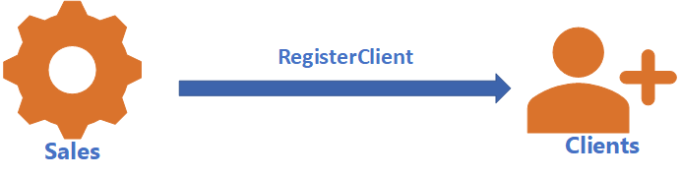
Messaging patterns: A command

Slide 10
Messaging patterns: A command
Commands should be expressed in a verb-noun sequence,
following the tell style
RegisterClient
ChangeAddress
SubmitOrder

Slide 11
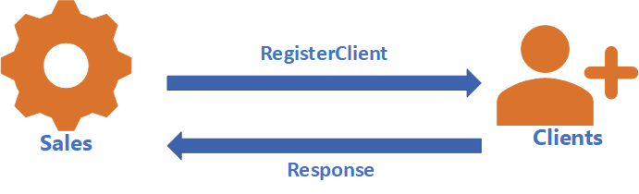
Messaging patterns: RPC
Request/response

Slide 12
Message Broker VS Message Bus
Another layer of abstraction can solve any problem in IT
Message bus is broker agnostic (an abstraction above message brokers). Like ORM DB providers in .NET or Log4net, etc.
Message bus takes care of low-level details like
Queues/Exchanges/Bindings
Acknowledgements
Serialization/Deserialization
Error handling
Retries/Resilience
Auditing
Developers can concentrate on sending and receiving messages.
Message bus – usually is language specific

Slide 13
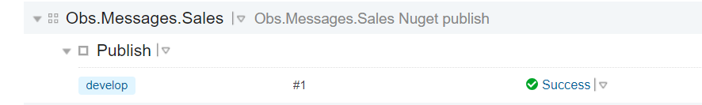
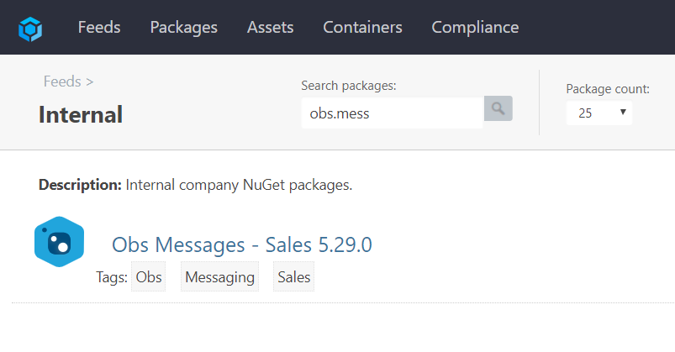
anatomy of messaging contract(just a
Nuget package)

Slide 14
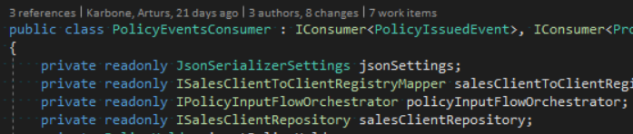
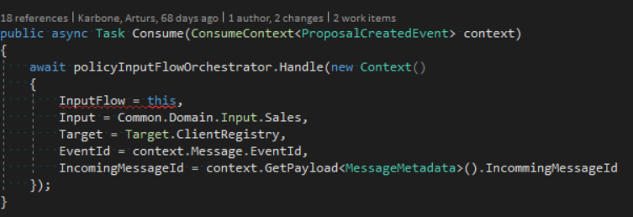
A consumer example: Definition

Slide 15
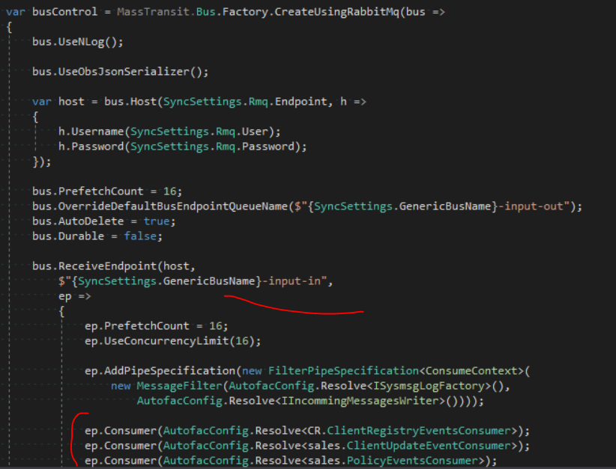
A consumer example: Consumption

Slide 16
Fire up rabbit
docker run -d --name myrabbit -p 15672:15672 -p 5672:5672 rabbitmq:3-management
docker start myrabbit

Slide 17
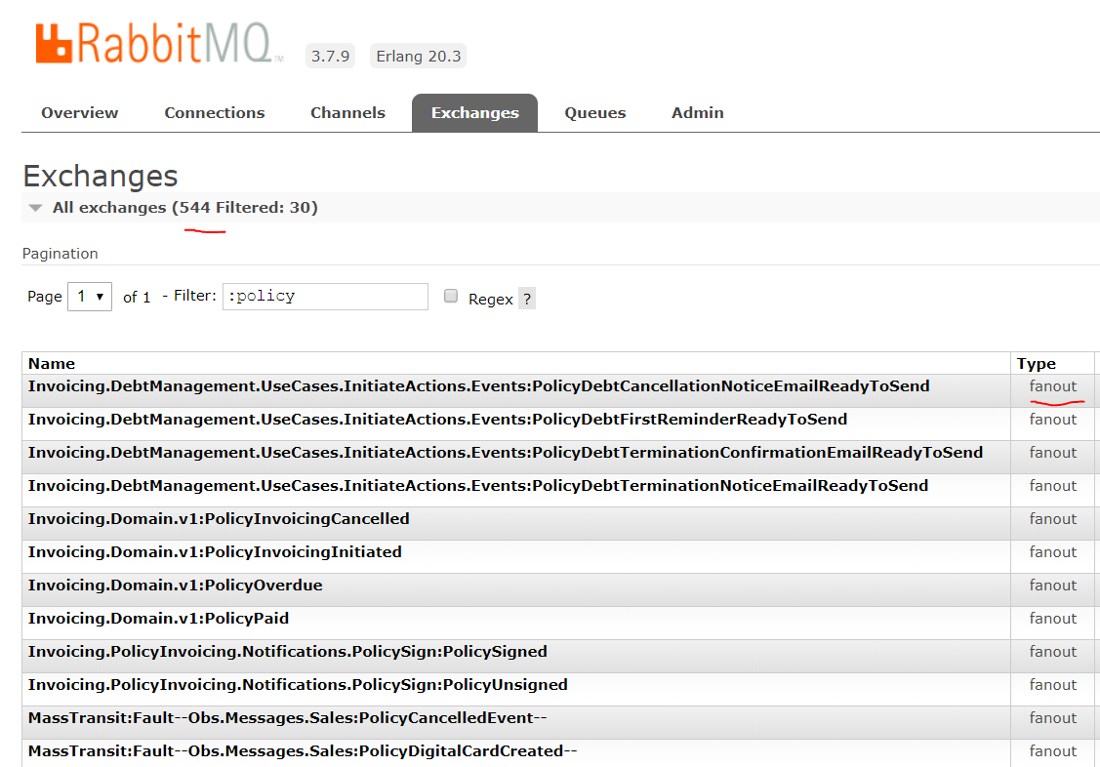
Demo: exchanges

Slide 18
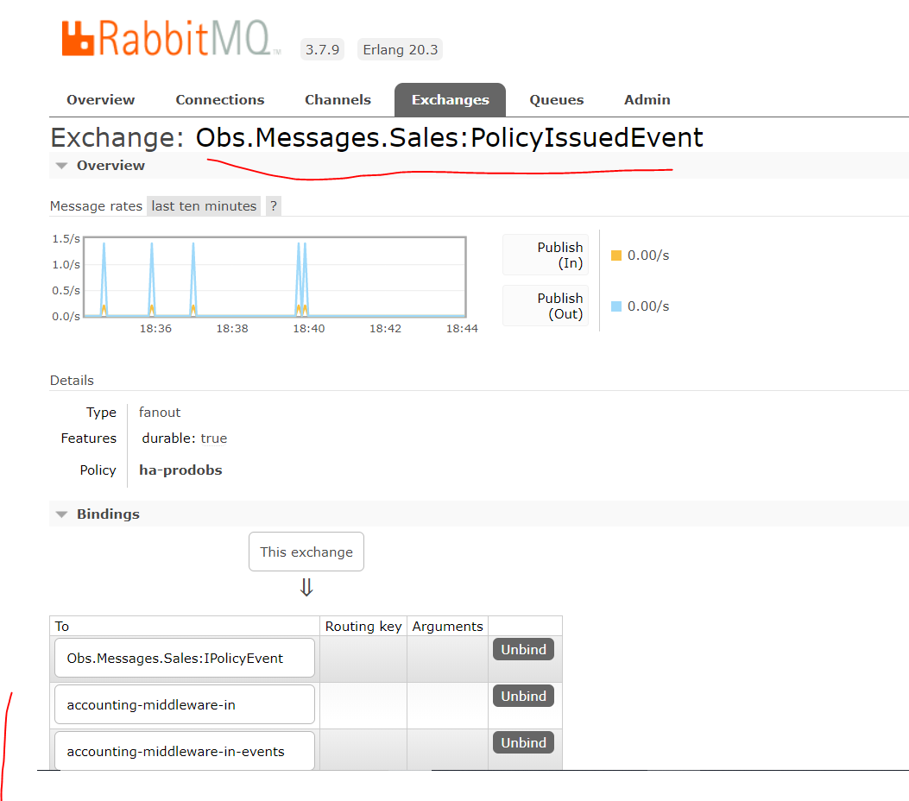
DEMO: Exchange bindings

Slide 19
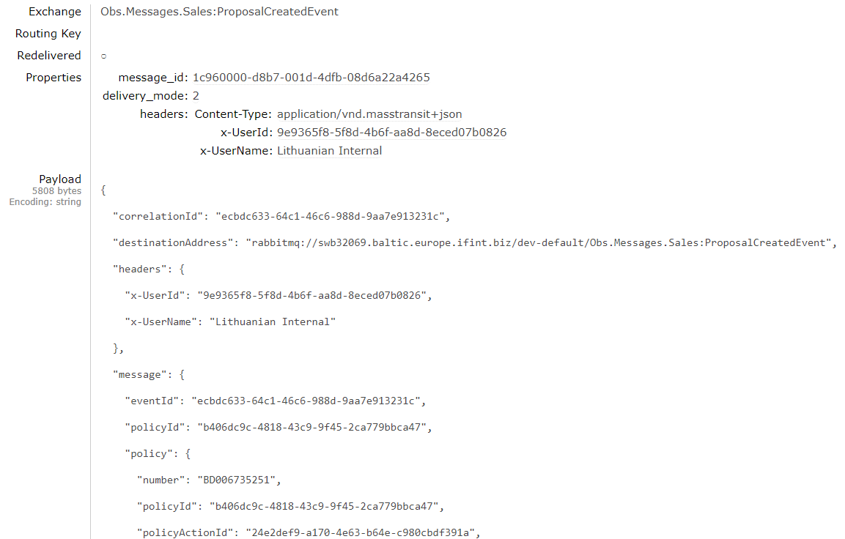
DEMO: message’s payload

Slide 20
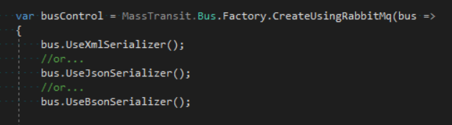
Serialization/deserialization

Slide 21
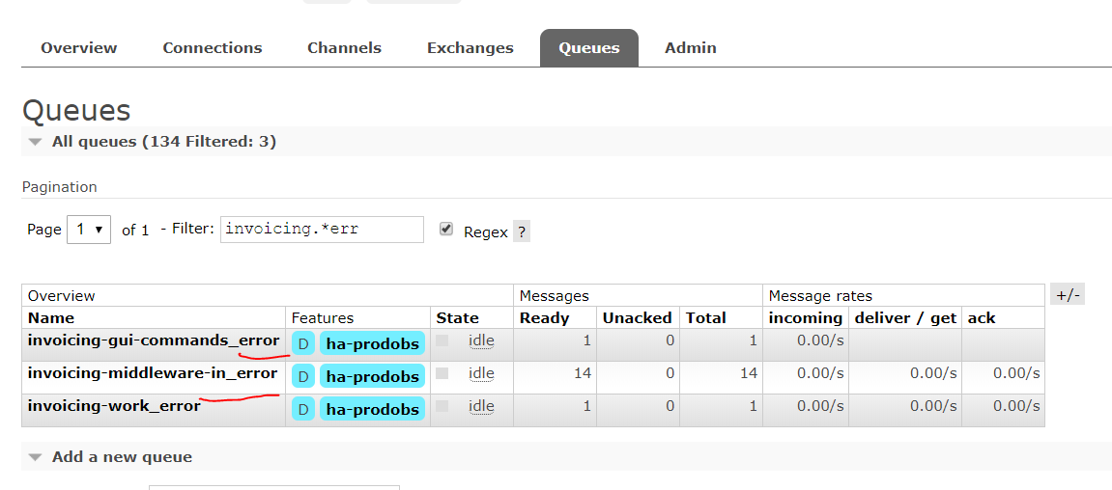
Error handling

Slide 22

resilience
Simple rule: Define policy & Define exceptions to handle
Supported Retry Policies
None
Immediate
Intervals
Exponential
Incremental

Slide 23
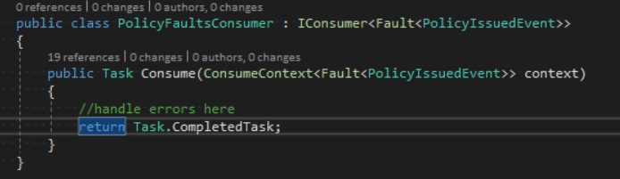
Consume errors

Slide 24
Symptoms when to use messaging
Integration with inner microservices
Integration with 3rd party (it is almost always a good idea)
Resilience
Truly async communication
Messaging in applications (menu notifies other components)
Domain events

Slide 25
Symptoms when to Masstransit
A distributed system consists of .NET services/apps
Developers want to concentrate on sending and receiving messages.
You already have experience with RabbitMq

Slide 26
Masstransit Learning Resources
https://stackoverflow.com/questions/tagged/masstransit
https://gitter.im/MassTransit/MassTransit
http://masstransit-project.com/MassTransit/learn/videos.html
https://www.pluralsight.com/courses/masstransit-rabbitmq-scaling-microservices

